Slide 1


CAMBRIAN PUBLIC SCHOOL KANKE ROAD,
RANCHI

Slide 2
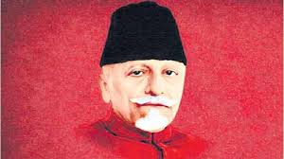
CELEBRATING NATIONAL EDUCATION DAY
REMEMBERING
MAULANA ABUL KALAM AZAD

Slide 3
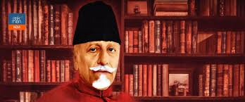
ABOUT MAULANA ABUL KALAM AZAD
1. He was an Indian scholar, Islamic theologian, independence activist and senior leader of the Indian National Congress during the Indian Independence Movement.
2. He was independent India’s first education minister and his birthday, 11th November, is celebrated as National Education Day.

Slide 4
THOUGHTS FOR EDUCATION BY MAULANA ABUL KALAM AZAD
“Educationists should build the capacities of the spirit of inquiry, creativity, entrepreneurial and moral leadership among students and become their role model”.

Slide 5
THOUGHTS FOR EDUCATION BY MAULANA ABUL KALAM AZAD
“Education is basic to the creation as an atmosphere in which human beings can meet one another in a plane of friendship and equality”.

Slide 6
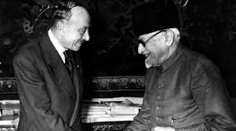
THOUGHTS FOR EDUCATION BY MAULANA ABUL KALAM AZAD
“Every individual has a right to an education that will enable him to develop his faculties and live a full human life”

Slide 7
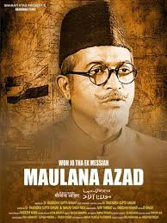
THOUGHTS FOR EDUCATION BY MAULANA ABUL KALAM AZAD
“Education imparted by heart can bring revolution in the society”.
“Climbing to the top demands strength, whether it is the top of Mount Everest or to the top of your career”.

Slide 8
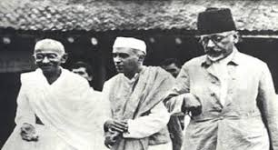
THOUGHTS FOR EDUCATION BY MAULANA ABUL KALAM AZAD
“Teaching by tongue can be perspired but by good deed can stay stronger”.

Slide 9
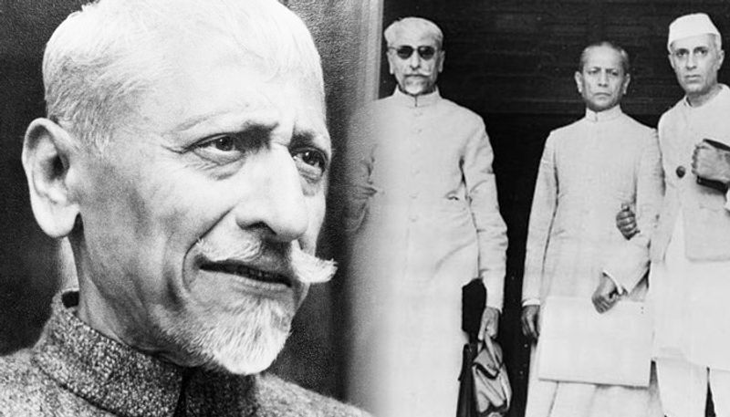
“As a child of God, I am greater than anything that can happen to me”.

Slide 10
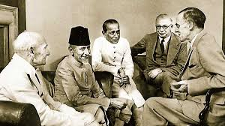
THOUGHTS FOR EDUCATION BY MAULANA ABUL KALAM AZAD
Slavery is worst even if it bears beautiful names.

Slide 11
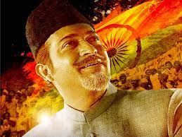
THOUGHTS FOR EDUCATION BY MAULANA ABUL KALAM AZAD
“Be more dedicated to making solid achievements than in running after swift but synthetic happiness”.

Slide 12
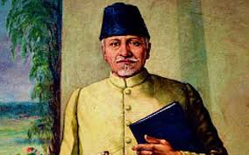
THOUGHTS FOR EDUCATION BY MAULANA ABUL KALAM AZAD
“To succeed in your mission, you must have single minded devotion to your goal”.

Slide 13
Thank you for watching this presentation!

